Slide 1
X-Volt: Joint Tuning of Driver Strengths and Supply Voltages Against Power Side-Channel Attacks
Saideep Sreekumar, Mohammed Ashraf, Mohammed Nabeel, Ozgur Sinanoglu, Johann Knechtel
New York University Abu Dhabi, UAE
ISPD2023

Slide 2
Outline
Abstract
Introduction
Threat Model
Methodology
Experimental Result
Layout Analysis
Conclusion

Slide 3
Outline
Abstract
Introduction
Threat Model
Methodology
Experimental Result
Layout Analysis
Conclusion

Slide 4
Abstract
Power side-channel (PSC) attacks are well-known threats to sensitive hardware like advanced encryption standard (AES) crypto cores
Supply voltage (VCCs) has significant impact on power profiles, so lots of defensed strategy based on VCCs tuning have been proposed
Driver strengths of cell also have direct and significant impact on power profiles, but was overlook in the past
This paper proposes a novel working principle for PSC attack of jointly tuning driver strengths and VCCs
Notes:
* power profiles(功率曲線)

Slide 5
Abstract
The steps are listed below:
Develop a simple circuit-level scheme for tuning
Implement a CAD flow for design-time evaluation of ASICs, enabling security assessment of ICs before tape-out
Implement correlation power analysis (CPA) framework for thoroughly security analysis
Implement AES design in ASIC and FPGA fabrics under various tuning scenario
Summarize design guideline for secure and efficient joint tuning
Notes:
* power profiles(功率曲線)

Slide 6
Outline
Abstract
Introduction
Threat Model
Methodology
Experimental Result
Layout Analysis
Conclusion

Slide 7
Introduction – Side Channel Analysis
To protect sensitive data handled within integrated circuits (ICs), the use of cryptographic (crypto) modules is widely adopted
Once the attacker accesses to ICs, they can monitor the runtime behavior and physical interactions with the environment :
Direct : measurement
Remote/Indirect : software interface to embedded sensors
They can infer the secret key used for crypto modules

Slide 8
Introduction – Side Channel Analysis
PCA (power channel analysis) is one kind of SCA (side channel analysis), and it has many types:
CPA (correlation power analysis) (used in this paper!)
DPA (differential power analysis)
mutual information analysis
machine learning-based techniques

Slide 9
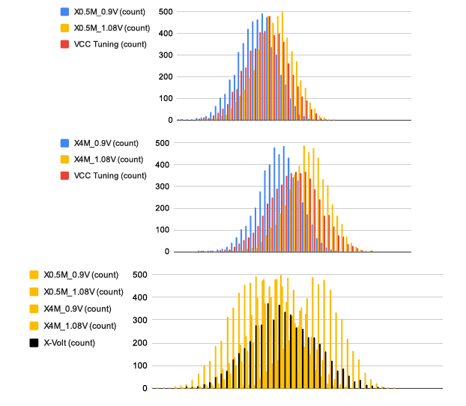
Introduction – Power Profile
Notes:
1.第一張圖是在driven strength固定在0.5M, 然後藍黃的線分別VCC為0.9V以及1.08V的情況，可以發現VCC調整導致的功率輪廓（紅色）與基準輪廓（藍色和黃色）大部分重疊
2.第二張圖是在driven strength固定在4M, 可以發現當driven strength改變後，VCC調整導致的功率輪廓（紅色)的重疊情況會與第一張圖不同
3.第三張圖就是聯合tune driven strength以及VCC的power profile(黑色)，可以發現他更加的分散 (所以意思就是說，聯合調整driven strength以及VCCs可以達到更好的防禦效果)

Slide 10
Outline
Abstract
Introduction
Threat Model
Methodology
Experimental Result
Layout Analysis
Conclusion

Slide 11
Threat Model
Attackers are passive observers, which means that they have direct and indirect access to ASIC or FPGA without control
Attackers can monitor the power consumption and the cipher-text, but has no control of plain-text and power supply
The operations of tuning are randomized (randomly switching between different tuning scenarios)
Thus attackers cannot ascertain the specific driver strength and VCCs underlying for any particular point in time or operation

Slide 12
Outline
Abstract
Introduction
Threat Model
Methodology
Experimental Result
Layout Analysis
Conclusion

Slide 13
The steps are listed below:
Develop a simple circuit-level scheme for tuning
Implement a CAD flow for design-time evaluation of ASICs, enabling security assessment of ICs before tape-out
Implement correlation power analysis (CPA) framework for thoroughly security analysis
Implement AES design in ASIC and FPGA fabrics under various tuning scenario
Summarize design guideline for secure and efficient joint tuning

Slide 14
Methodology
Registers are most relevant for PSC attacks, since they build up considerable correlation between the processed data and the observable power consumption
The AES keys also store in the registers
Notes:
一開始會先建立簡單的的circuit scheme進行進行tuning

Slide 15
ASICs - Runtime Tuning of Driven Strength
Static Driven-Strength
For the static driven-strength tuning during design time, they reconfigure the strength of each register of choice
They randomly select the highest available strength or the lowest available strength
To maintain the selected strength throughout the design flow, they make these register as don’t touch
Notes:
一開始會先建立簡單的的circuit scheme進行進行tuning

Slide 16
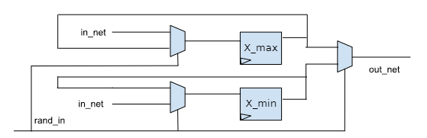
ASICs - Runtime Tuning of Driven Strength
Dynamic Driven-Strength
They design a tunable register (which is marked as don’t touch)
Notes:
The pair of registers, which is one with the high available strength, and the other with the low strength
The tunable register ouputs one of below signal: (a) the signal with stronger strength (b) the signal with weaker strength
3. The in_net signal will also feedback to the Mux, which prevents the toggle of the signal

Slide 17
ASICs - Runtime Tuning of VCCs
They assume that IVRs (integrated voltage regulator) or other tuning features are available
Dynamic VCC tuning is required only once per full AES round, because the CPA attack focuses on the last or first intermediate round of AES operation

Slide 18
FPGA - Runtime Tuning of Driven Strength
FPGA cannot reconfigure cell driven strength
So they reconfigure the driven strength and other parameter of the I/O pins

Slide 19
FPGA - Runtime Tuning of Driven Strength
Static Driven-Strength
They connects and hard-wires the register of choice to a I/O pin with highest/lowest driven strength

Slide 20
FPGA - Runtime Tuning of Driven Strength
Dynamic Driven-Strength
For the selected register, they connect the output of register of choice to two I/O pins, which is one with the high available strength, and the other with the low strength (same as above) (also use MUXes to select)

Slide 21
FPGA - Runtime Tuning of VCCs
They assume that some tuning feature is available, like FPGA on-board voltage regulation

Slide 22
The steps are listed below:
Develop a simple circuit-level scheme for tuning
Implement a CAD flow for design-time evaluation of ASICs, enabling security assessment of ICs before tape-out
Implement correlation power analysis (CPA) framework for thoroughly security analysis
Implement AES design in ASIC and FPGA fabrics under various tuning scenario
Summarize design guideline for secure and efficient joint tuning

Slide 23
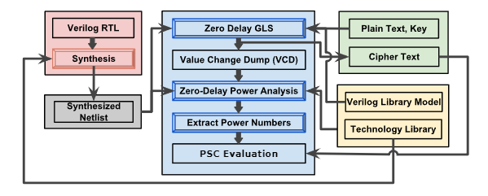
CAD Flow for Design-Time Evaluation of ASIC Power Profile
Notes:
接著會進行power analysis，以獲取actual power (in a design-time simulation environment, without need
for FPGA implementation or even IC tape-out and measurements)
Input : (1) RTL (AES crypto core) (2) standard cell library (tech file 、 verilog library model) (3) plain-texts and keys

Slide 24
CAD Flow for Design-Time Evaluation of ASIC Power Profile
The CAD flow serves to investigate the role that joint tuning of driven strengths and VCCs in the early design simulation time
The flow provides zero-delay power value (only the circuit-level computation as triggered by the plain-text and key inputs), and without any impact of layout effect or noises

Slide 25
CAD Flow for Design-Time Evaluation of ASIC Power Profile
Steps:
Synthesis RTL code
Also check its correctness
Perform zero-delay gate level simulation of the design
Dump VCD files after simulation
Do power simulation of the gate level simulation
To prevent compromising the result of PSC attack, only focus on the last(or first) round of AES

Slide 26
CAD Flow for Design-Time Evaluation of ASIC Power Profile
Scope of simulation :
They leverage noise-free zero-delay simulation
The glitches(noises) are less relevant to tuning driven strength and VCCs
Tuning has significant impact on not only power profiles overall but glitching activities
In the noise-free zero-delay simulation, it is easy to extract the information of peak-power value which is important for PSC attackers
Notes:
在這種零延遲模擬中，所有耗電的轉換在時鐘邊緣同時發生。因此，對於側信道攻擊來說特別重要的峰值功率值可以很容易地提取出來

Slide 27
The steps are listed below:
Develop a simple circuit-level scheme for tuning
Implement a CAD flow for design-time evaluation of ASICs, enabling security assessment of ICs before tape-out
Implement correlation power analysis (CPA) framework for thoroughly security analysis
Implement AES design in ASIC and FPGA fabrics under various tuning scenario
Summarize design guideline for secure and efficient joint tuning

Slide 28
CPA framework of security analysis
Use linear Pearson correlation coefficient (PCC)
Quantify the relationship between actual power and hypothetical power
Hypothetical power can be obtained by all possible keys values (can use the above power analysis flow to get the most promising candidate for all bytes, and then concatenates them to form the guess of correct key value)
Notes:
接著會進行CPA，以此來找到最有可能的金鑰值
皮爾森積差相關係數

Slide 29
CPA framework of security analysis
Steps:
Build up HD (Hamming Distance) power model
Evaluate the PCC value

Slide 30
Build up HD power model
The register consumes a significant share of dynamic power during data transition
So the Hamming Distance for the register’s data before and after switching operations is established as Hamming Distance Model
We can reverting the AES last-round operation using the observed cipher-texts, and computing and memorizing the HD when considering all possible key values for that reverse operation

Slide 31
Evaluate the PCC value
The actual power are correlated against all hypothetical power profiles
The highest PCC value across a number of traces is assumed to represent the correct key
The correlation analysis is conducted at the byte level

Slide 32
Outline
Abstract
Introduction
Threat Model
Methodology
Experimental Result
Layout Analysis
Conclusion

Slide 33
Experimental Result - Setup
Synthesis : Design Compiler
VCS : Gate Level power simulation
Xilinx ISE Webpack Suite : FPGA Implementation
Implement CPA with C++

Slide 34
Experimental Result - Design
Utilize a regular AES core, with 128-bit keys and 128-bit texts processed in electronic code book (ECB) mode.

Slide 35
Experimental Result - Implementation
For ASIC : Employ a commercial 55nm technology by GlobalFoundries for logic synthesis and zero-delay gate-level power simulation
For FPGA : use a Sakura-X board, specifically its Kintex-7 FPGA chip, which is manufactured in a 28nm technology
ASIC and FPGA implementation differ considerably because:
Available driver strength
Process and hardware fabrics and VCCs
Noise profile

Slide 36
Metrics and Workflow for Security Analysis
They report the minimal number of traces needed to disclosure as #TTD(𝑐%, t), i.e., for a confidence value 𝑐 across 𝑡 randomized CPA trials
#TTD(90%, 1k) : For example, if we want to get 90% confidence level, then they will do multiple CPA campaigns. Each campaigns run independently with different sets of randomly selected plain-texts. Until achieving 90% confidence level, we will calculate number of CPA we have done (In this case, 1000)

Slide 37
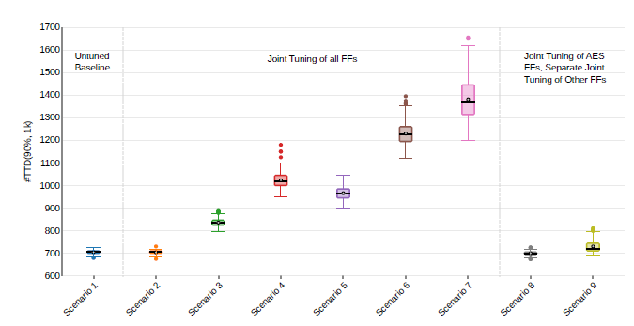
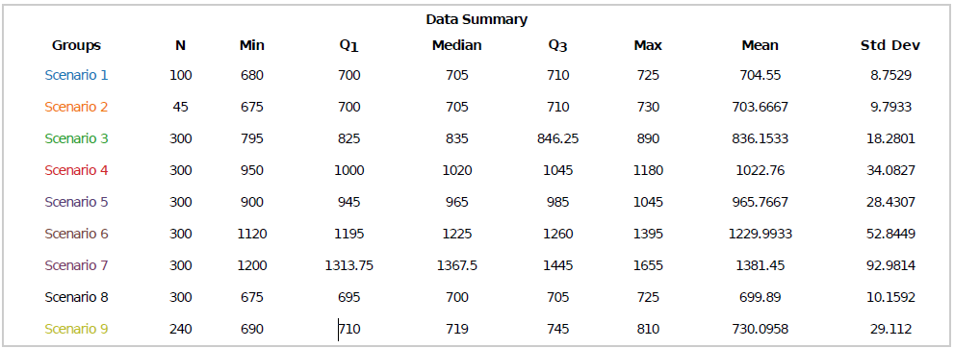
Experimental Result - ASIC Implementation
Notes:
Scenario 1 : VCC is set to 1.08V for all FFs and all other gates

Slide 38
Tuning Setting (I): For static or dynamic tuning
Scenario 2 : Static X, VCC
Driver strength : five available driver strengths, ranging from X0.5 to X4
VCCs : three available VCCs, ranging from 0.9V to 1.08V
Only little difference to the untuned baseline, so it indicates that exclusively static tuning is not effective

Slide 39
Tuning Setting (I): For static or dynamic tuning
Scenario 3 : Static X0.5, Dynamic VCC
Driver strength : driver strengths are set to X0.5 for all FFs
VCCs : VCC tuning across 0.9–1.08V
More resilient than static tuning (Scenario 2)

Slide 40
Tuning Setting (I): For static or dynamic tuning
Scenario 4 : Static X4, Dynamic VCC
Driver strength : driver strengths are set to X4 for all FFs
VCCs : VCC tuning across 0.9–1.08V
More resilient than lower driven strength (Scenario 3)

Slide 41
Tuning Setting (I): For static or dynamic tuning
Scenario 5 : Dynamic X, Static 0.9V
Driver strength : driver strengths tuning across X0.5–X4
VCCs : 0.9V for all FFs
More resilient than lower driver strength (Scenario 3), while less resilient than
higher driver strength (Scenario 4)

Slide 42
Tuning Setting (I): For static or dynamic tuning
Scenario 6 : Dynamic X, Static 1.08V
Driver strength : driver strengths tuning across X0.5–X4
VCCs : 1.08V for all FFs
More resilient than all prior ones
For dynamic driver-strength tuning,
high VCCs can be beneficial

Slide 43
Tuning Setting (II): Separate tuning of FFs holding AES texts versus all other FFs
Scenario 8 : Static Only
Driver strength : five available driver strengths, ranging from X0.5 to X4
VCCs : 0.9V and 1.08V are considered
Even less resillient than scenario 2

Slide 44
Tuning Setting (II): Separate tuning of FFs holding AES texts versus all other FFs
Scenario 9 : Static and Dynamic
For FF with AES keys
Dynamic tuning
For the other FFs
Static tuning, with driver strength = X0.5 or X4, and VCCs = 0.9V or 1.08V
Limiting dynamic tuning to only the FFs holding AES texts is not effective

Slide 45
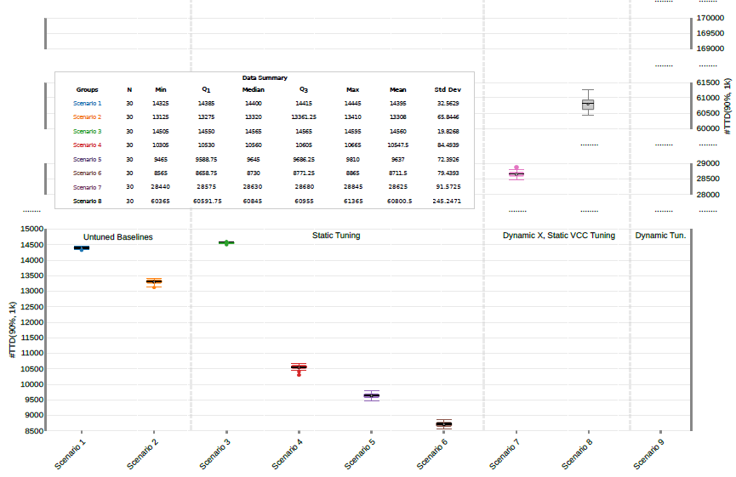
Experimental Result - FPGA Implementation
Notes:
Scenario 1 : Untuned Baseline with 0.955V
Scenario 2 : Untuned Baseline with 1.055V (Lower VCCs is beneficial)

Slide 46
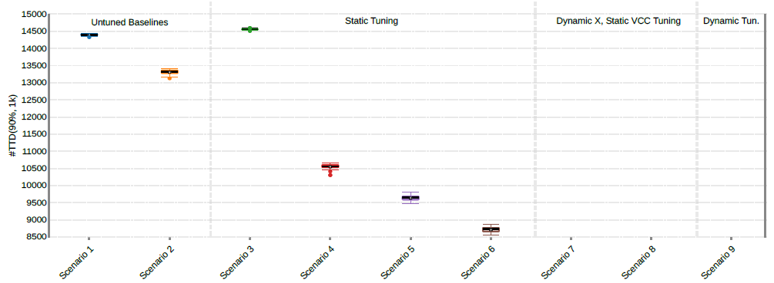
Tuning Setting : Tuning of FFs holding AES texts
Scenario 3 : Static X4, 0.955V
Driver strength : driver strengths are set to X4 for all FFs
VCCs : 0.955V
Static tuning with low driver strength is not effective
Notes:
Not to tune other FFs because of limited I/O pins

Slide 47
Tuning Setting : Tuning of FFs holding AES texts
Scenario 4 : Static X4, 1.055V
Driver strength : driver strengths are set to X4 for all FFs
VCCs : 1.055V
Significant drop occurs

Slide 48
Tuning Setting : Tuning of FFs holding AES texts
Scenario 5 : Static X16, 0.955V
Driver strength : driver strengths are set to X16 for all FFs
VCCs : 0.955V

Slide 49
Tuning Setting : Tuning of FFs holding AES texts
Scenario 6 : Static X16, 1.055V
Driver strength : driver strengths are set to X16 for all FFs
VCCs : 1.055V
In conclusion, Static tuning is most often counterproductive
Notes:
due to increased information leakage incurred via toggling IO pins according to AES texts held in the related FFs

Slide 50
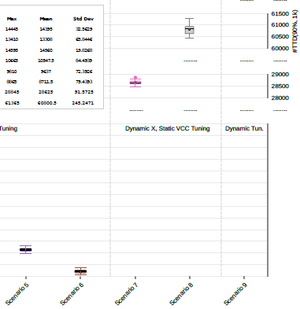
Tuning Setting : Tuning of FFs holding AES texts
Scenario 7 : Dynamic X, Static 0.955V
Driver strength : driver strengths tuning across X4–X16
VCCs : Set to 0.955V
Dynamic driver-strength tuning is effective
Notes:
due to increased information leakage incurred via toggling IO pins according to AES texts held in the related FFs

Slide 51
Tuning Setting : Tuning of FFs holding AES texts
Scenario 8 : Dynamic X, Static 1.055V
Driver strength : driver strengths tuning across X4–X16
VCCs : Set to 1.055V
High VCCs can be beneficial in combination with dynamic driver-strength tuning
Notes:
due to increased information leakage incurred via toggling IO pins according to AES texts held in the related FFs

Slide 52
Tuning Setting : Tuning of FFs holding AES texts
Scenario 9 : Dynamic X, Dynamic VCC
joint and dynamic tuning is by far most resilient
Notes:
due to increased information leakage incurred via toggling IO pins according to AES texts held in the related FFs

Slide 53
Outline
Abstract
Introduction
Threat Model
Methodology
Experimental Result
Layout Analysis
Conclusion

Slide 54
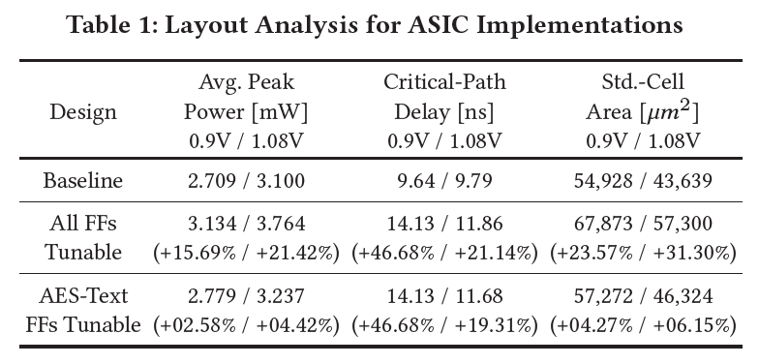
Layout Analysis – ASIC Implementation
Notes:
Layout costs are larger when all FFs are tunable, whereas costs are reasonable if only FFs holding AES texts are tunable

Slide 55
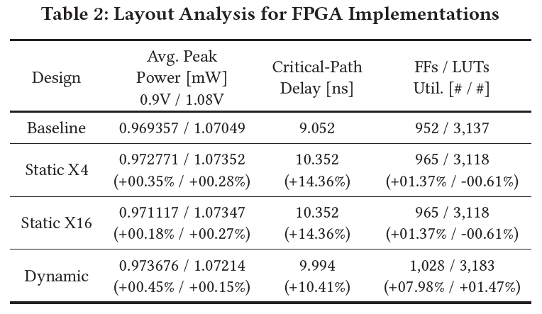
Layout Analysis – FPGA Implementation
Notes:
Layout costs are larger when all FFs are tunable, whereas costs are reasonable if only FFs holding AES texts are tunable

Slide 56
Outline
Abstract
Introduction
Threat Model
Methodology
Experimental Result
Layout Analysis
Conclusion

Slide 57
Conclusion
In the experiment, they found that:
Runtime tuning is more effective than static tuning in both ASIC and FPGA
Dynamic driver-strength tuning, along with high VCCs or dynamic VCC tuning, is most effective
In FPGA, the AES core is rendered > 11.8x as resilient as the untuned baseline design
In FPGA, layout overhead is around +10% critical path delay in the most resilient design, which is acceptable
Notes:
Tuning of all FFs is promising, but is also limited in practice (by available IO pins for the FPGA implementation and by overheads for the ASIC implementation
Static tuning is least effective in general and even counterproductive for the FPGA implementation (where implicit masking by environmental noises can be nullified when using high VCCs and/or high driver strengths for tuning).

Slide 58
Thanks for listening!

